Slide 1

SMART BINS
Juan Santacruz Olías
Laura González López
Miguel Ventoso Fernández
Javier Campoy Heredero
OPEN DATA AND KNOWLEDGE GRAPHS
HANDS ON – GROUP 03

Slide 2
CONTENTS
Select, Obtain Access and Analyse Data Source
Naming strategy and ontology
Data Preparation
RDF Generation
Data Linking
Application

Slide 3

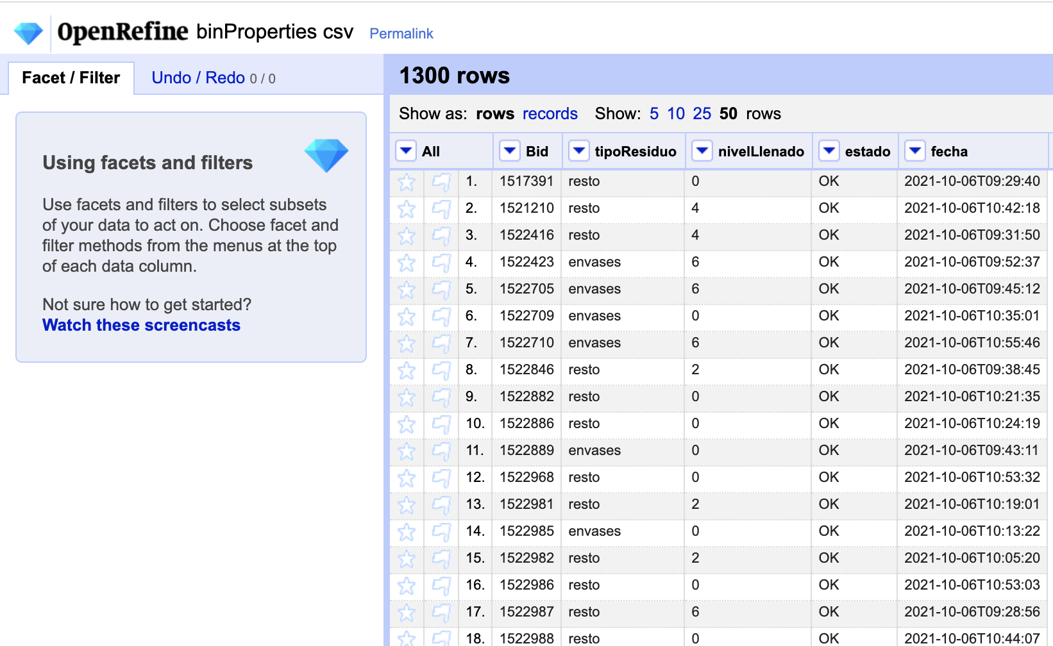
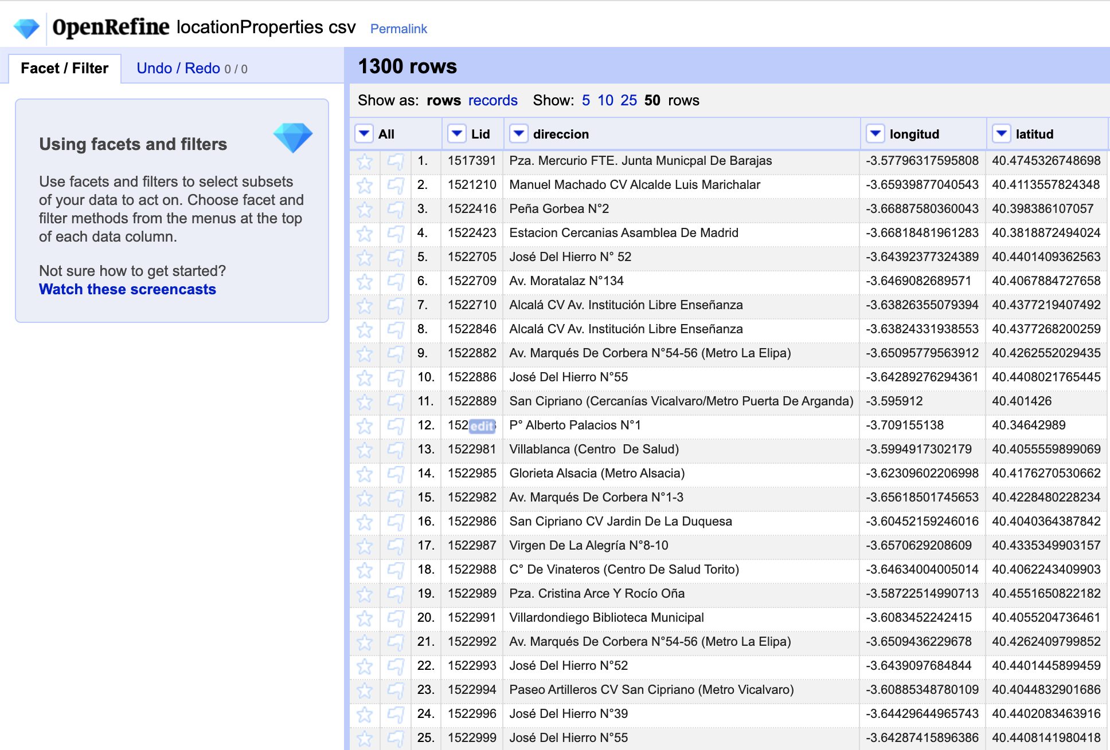
Select, Obtain Access and Analyse Data Source
Our dataset gathers data from different smart solar trash bins all over Madrid, displaying their location, availavility, the type of waste they contains, and the capacity of each one.
License: The data has an open license, allowing its use either for commercial or non commercial purposes
Bin Properties
Location Properties

Slide 4
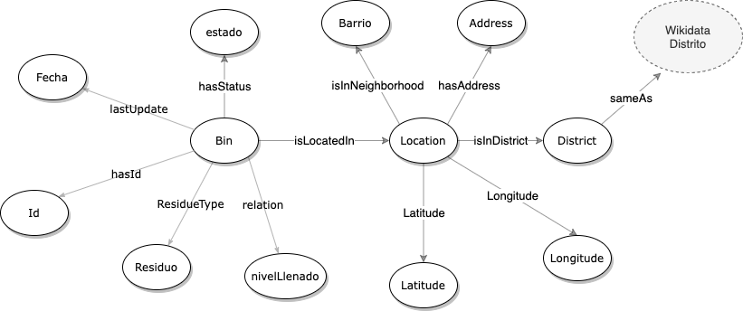
Naming strategy and ontology
Base URI: http://www.group03.org/smartbins
Ontology: /ontology
Resources: /resource

Slide 5
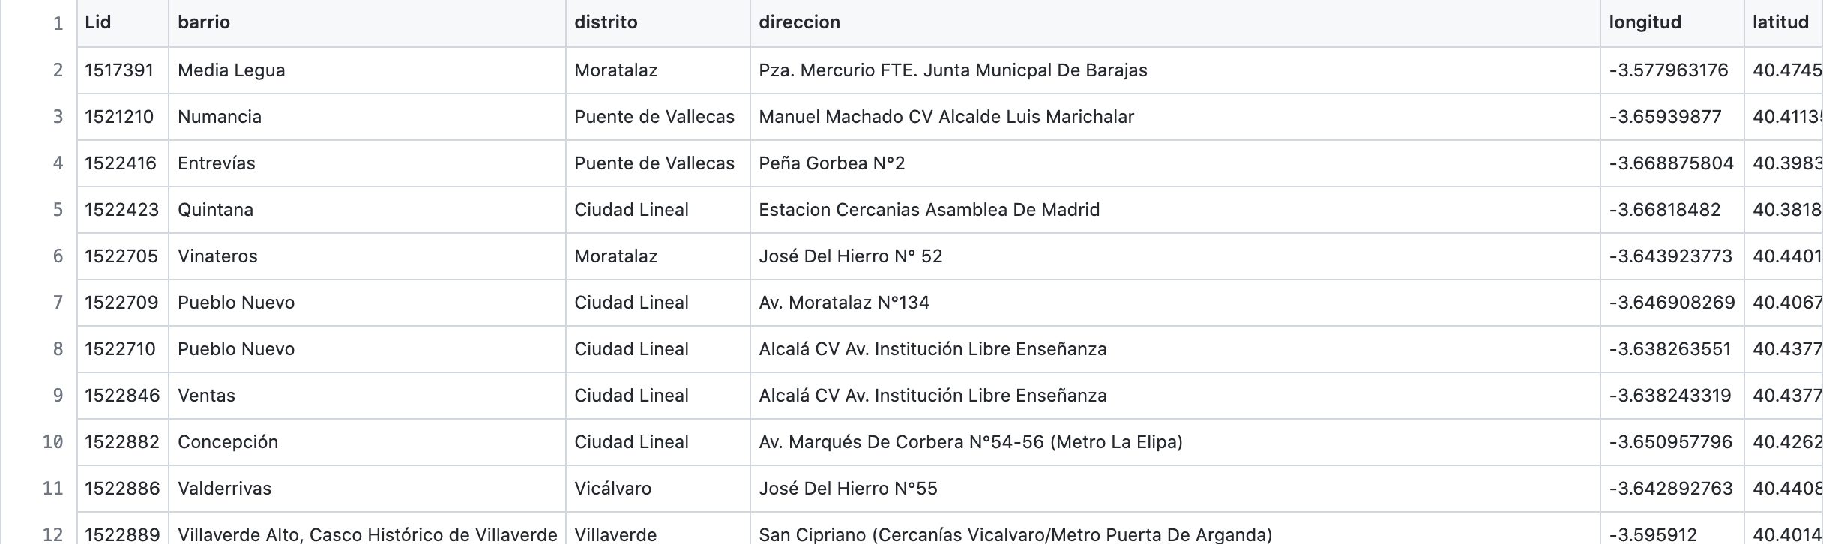
DATA PREPARATION

Slide 6

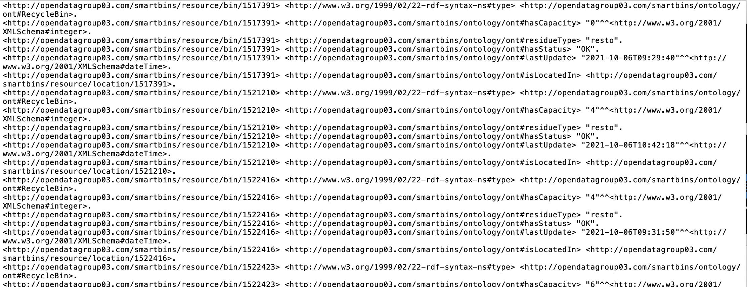
RDF Generation
rml mappings
.yml transformation
Generate RDF

Slide 7

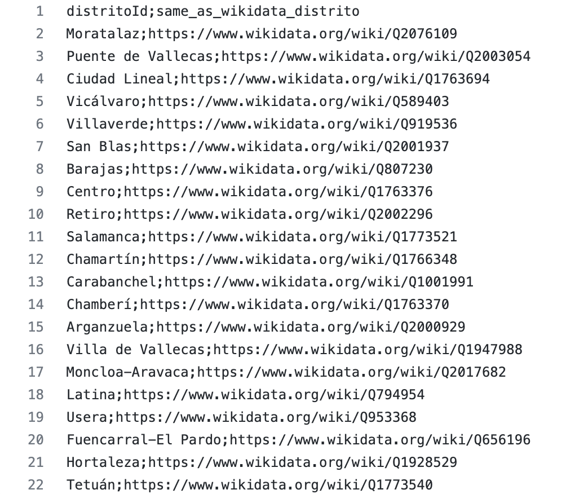
Data linking

Slide 8

APPLICATION

Slide 9
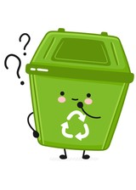
ANY QUESTIONS?
Thank you for your attention!

